Slide 1
WRES2203 Advanced Network Technology
Chapter 8
Point-to-Point Connections

Slide 2
Contents
Introduction
WAN Encapsulation
PPP
Configuring PPP
PPP Authentication
Configuring PPP Authentication

Slide 3
Introduction
Point-to-Point connection is the most common types of WAN connections, especially in long-distance communications.
It is used to connect LANs to service provider WANs, and to connect LAN segments within an enterprise network.
A LAN-to-WAN point-to-point connection is also referred to as a serial connection or leased-line connection.
Leased lines are a frequently used type of WAN access, and they are generally priced based on the bandwidth required and the distance between the two connected points.

Slide 4
Introduction
Communications across a serial connection is a method of data transmissions in which the bits are transmitted sequentially over a single channel.
Parallel communications can transmit simultaneously over multiple wires. However, parallel communications do have issues with crosstalk across wires, especially as the wire length increases.
Clock skew is also an issue with parallel communications. Clock skew occurs when data across the various wires does not arrive at the same time, creating synchronization issues.

Slide 5
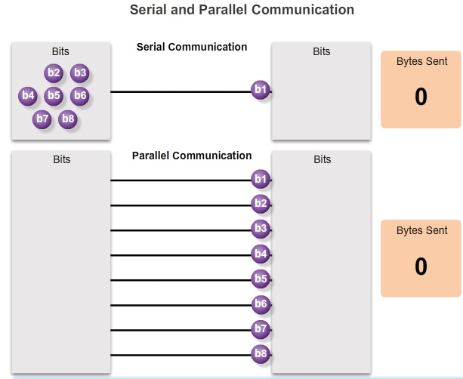
Introduction

Slide 6
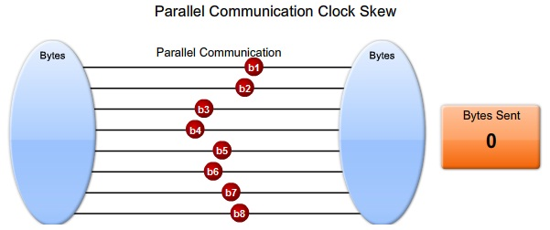
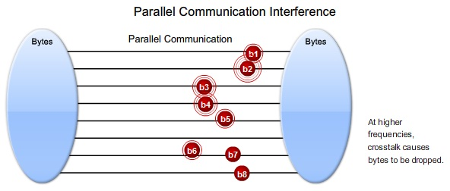
Introduction

Slide 7
Introduction
Serial communication
  RS-232
    Both 9-pin and 25-pin connectors are used.
  V.35
    Typically used for modem-to-multiplexer communication.
    V.35 is the interface standard used by most routers and DSUs that connect to T1 carriers.
  High-Speed Serial Interface (HSSI)
    supports transmission rates up to 52 Mb/s.

Slide 8
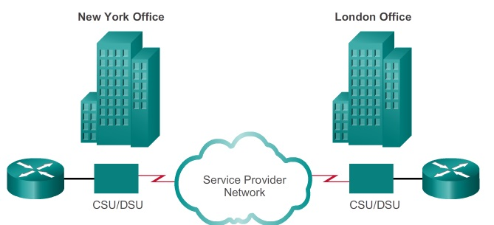
Introduction
A point-to-point link is used to provide a single, pre-established WAN communications path from the customer premises, through the provider network, to a remote destination.

Slide 9
Introduction
Time-division Multiplexing (TDM)
  Divides the bandwidth of a single link into separate channels or time slots.
  Allocating a different time interval for the transmission of each channel.
  Increases the capacity of the transmission link by slicing time into smaller intervals so that the link carries the bits from multiple input sources.
  A multiplexer (MUX) breaks each signal into segments and puts each segment into a single channel by inserting each segment into a timeslot.

Slide 10
Introduction
Statistical Time Division Multiplexing
  Uses a variable time slot length allowing channels to compete for any free slot space.
An example of a technology that uses synchronous TDM is ISDN.
On a larger scale, the telecommunications industry uses the SONET for synchronous TDM over fiber.

Slide 11
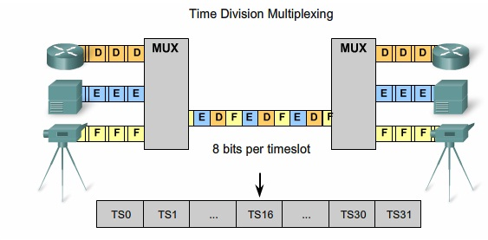
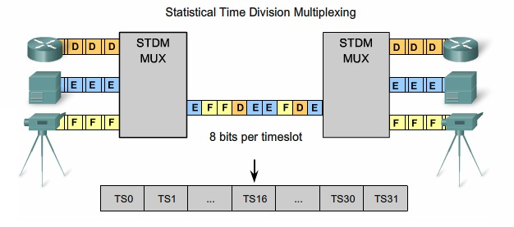
Introduction

Slide 12
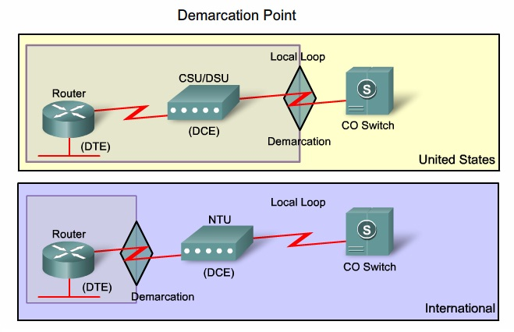
Introduction
The demarcation point is the point in the network where the responsibility of the service provider ends.

Slide 13
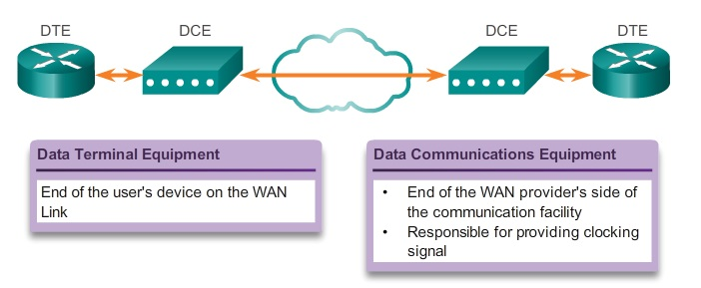
Introduction
A serial connection has a DTE device at one end of the connection and a DCE device at the other end. One of the serial interfaces must be configured as the DCE end to provide the clock signal for the connection.

Slide 14
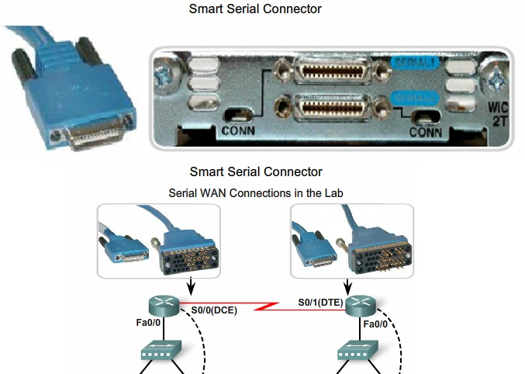
Introduction

Slide 15
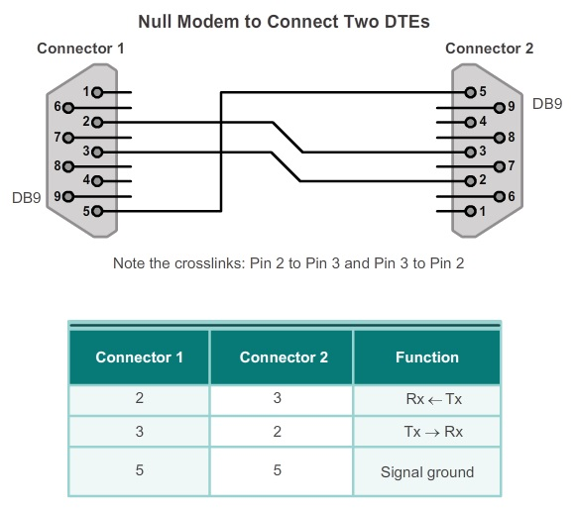
Introduction

Slide 16
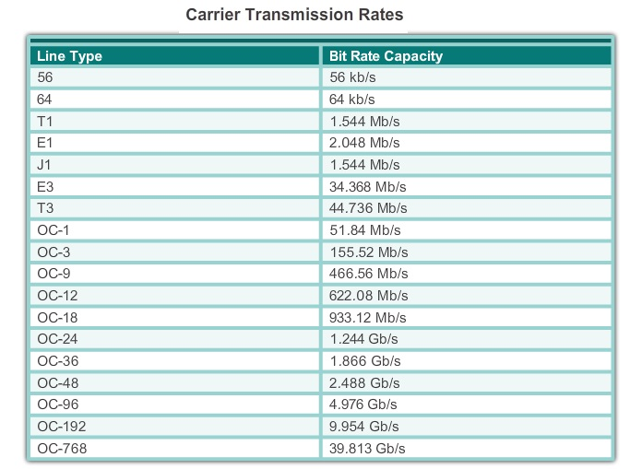
Introduction
Bandwidth refers to the rate at which data is transferred over the communication link.

Slide 17
WAN Encapsulation
On each WAN connection, data is encapsulated into frames before crossing the WAN link.
WAN Protocols
  HDLC
    The default encapsulation type on point-to-point connections, dedicated links, and circuit-switched connections
  PPP
    Provides router-to-router and host-to-network connections over synchronous and asynchronous circuits.

Slide 18
WAN Encapsulation
  Serial Line Internet Protocol (SLIP)
    A standard protocol for point-to-point serial connections using TCP/IP. SLIP has been largely displaced by PPP.
  X.25/Link Access Procedure Balanced (LAPB)
    defines how connections between a DTE and DCE are maintained.
  Frame Relay
    Data Link layer protocol that handles multiple virtual circuits. Frame Relay is a next generation protocol after X.25.

Slide 19
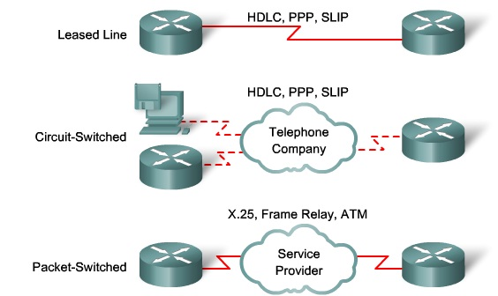
WAN Encapsulation
  ATM
    Devices send multiple service types (such as voice, video, or data) in fixed-length (53-byte) cells.

Slide 20
WAN Encapsulation
HDLC
  A synchronous Data Link layer bit-oriented protocol
  Provides both connection-oriented and connectionless service.
  uses synchronous serial transmission to provide error-free communication between two points.
  uses a frame delimiter, or flag, to mark the beginning and the end of each frame.
  Flag
    The flag field initiates and terminates error checking.
    The frame always starts and ends with an 8-bit flag field. The bit pattern is 01111110.

Slide 21
WAN Encapsulation
  Always inserts a 0 bit after every five 1s in the data field.
  When frames are transmitted consecutively, the end flag of the first frame is used as the start flag of the next frame.
  Address
    communication source or a destination.
  Control
    Information (I) frame
      I-frames carry upper layer information and some control information. This frame sends and receives sequence numbers, and the poll final (P/F) bit performs flow and error control.

Slide 22
WAN Encapsulation
    Supervisory (S) frame
      S-frames provide control information.
      An S-frame can request and suspend transmission, report on status, and acknowledge receipt of I-frames.
    Unnumbered (U) frame
      U-frames support control purposes and are not sequence.
  Protocol
    specifies the protocol type

Slide 23
WAN Encapsulation
  Data
    contains a Path Information Unit (PIU) or Exchange Identification (XID) information.
  Frame check sequence (FCS)
    The FCS precedes the ending flag delimiter and is usually used for Cyclic Redundancy Check (CRC) at the receiver.

Slide 24

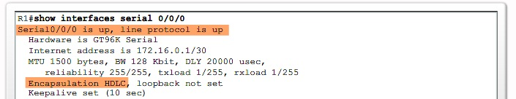
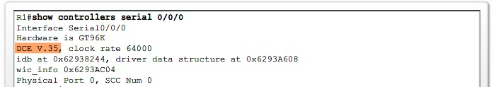
WAN Encapsulation

Slide 25
PPP
PPP encapsulates data frames for transmission over Layer 2 physical links.
PPP contains three main components:
  HDLC protocol for encapsulating datagrams over point-to-point links.
  Extensible Link Control Protocol (LCP) to establish, configure and test the data link connection.
  Family of Network Control Protocols (NCPs) for establishing and configuring different Network layer protocols.
PPP supports PAP and CHAP authentication.

Slide 26
PPP
Link Control Protocol (LCP) Layer
  has a role in establishing, configuring, and testing the data-link connection.
  negotiates and sets up control options on the WAN data link
  Handling varying limits on packet size
  Detecting common misconfiguration errors
  Terminating the link
  Determining when a link is functioning properly or when it is failing

Slide 27
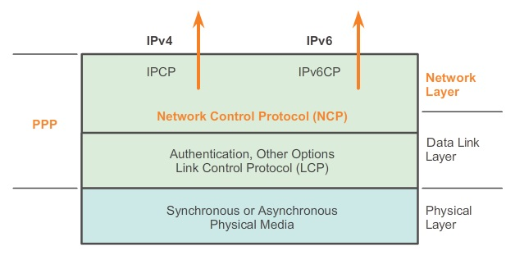
PPP
Network Control Protocol (NCP) Layer
  PPP permits multiple Network layer protocols to operate on the same communications link.
  For every Network layer protocol used, PPP uses a separate NCP.

Slide 28
PPP
Establishing a PPP Session
  Phase 1: Link establishment and configuration negotiation
    LCP must first open the connection and negotiate configuration options.
  Phase 2: Link quality determination
    LCP tests the link to determine whether the link quality is sufficient to bring up Network layer protocols.
  Phase 3: Network layer protocol configuration negotiation
    The appropriate NCP can separately configure the Network layer protocols, and bring them up and take them down at any time.

Slide 29
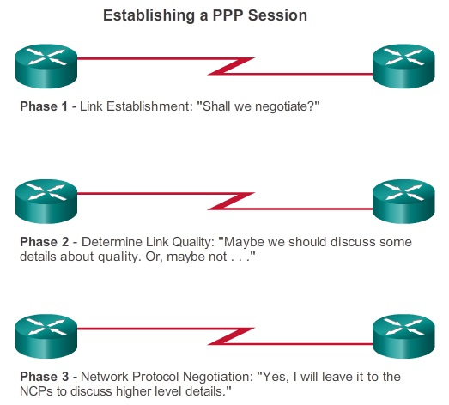
PPP

Slide 30
PPP
Link Establishment
  LCP opens the connection and negotiates the configuration parameters. Initiating device sending a Configure-Request frame to the responder.
  The request consists of how the link created, including protocol or authentication parameters.
  The responder accepts the request with a Configure-Ack message. The operation of the link is handed over to the NCP.
  If the options are not acceptable, the responder sends a Configure-Nak or Configure-Reject and the link is not established.

Slide 31
PPP
Link Maintenance
  Code-Reject and Protocol-Reject
    These frame types provide feedback when one device receives an invalid frame due to an unrecognized LCP frame type or a bad protocol identifier.
  Echo-Request, Echo-Reply, and Discard-Request
    These frames can be used for testing the link.
Link Termination
  The device initiating the shutdown sends a Terminate-Request message. The other device replies with a Terminate-Ack.

Slide 32
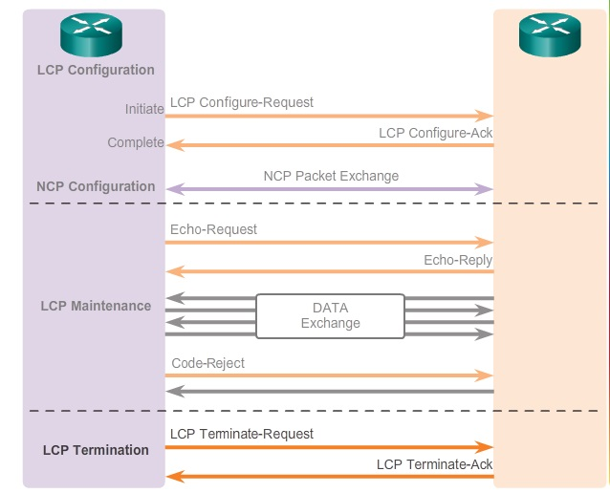
PPP

Slide 33
PPP
After the link has been initiated, the LCP passes control to the appropriate NCP. Each network protocol has a corresponding NCP. There are NCPs for IPv4, IPv6, IPX, AppleTalk, and many others.
IPCP is responsible for configuring, enabling, and disabling the IPv4 modules on both ends of the link. IPV6CP is an NCP with the same responsibilities for IPv6.
After the NCP process is complete, the link goes into the open state and LCP takes over again in a link maintenance phase.
When data transfer is complete, NCP terminates the protocol link; LCP terminates the PPP connection.

Slide 34
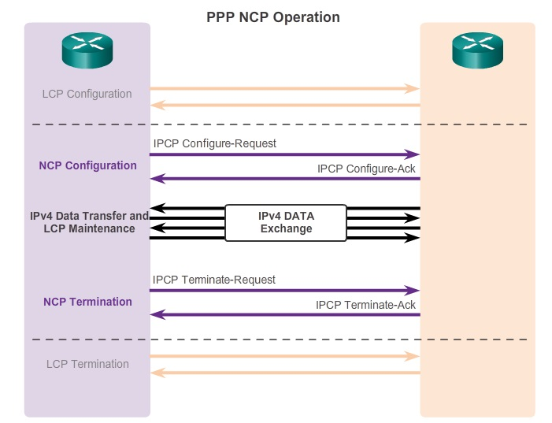
PPP

Slide 35
PPP
PPP can be configured to support various functions:
  Authentication
    Peer routers exchange authentication messages. Two authentication choices are Password Authentication Protocol (PAP) and Challenge Handshake Authentication Protocol (CHAP).
  Compression
    Increases the effective throughput on PPP connections by reducing the amount of data in the frame that must travel across the link.
    Stacker and Predictor

Slide 36
PPP
  Error detection
    Identifies fault conditions.
    The Quality and Magic Number options help ensure a reliable, loop-free data link.
  Multilink
    Multilink PPP provides a method for spreading traffic across multiple physical WAN links while providing packet fragmentation and reassembly, proper sequencing, multivendor interoperability, and load balancing on inbound and outbound traffic.
  PPP Callback
    The client makes the initial call, requests that the server call it back, and terminates its initial call.

Slide 37
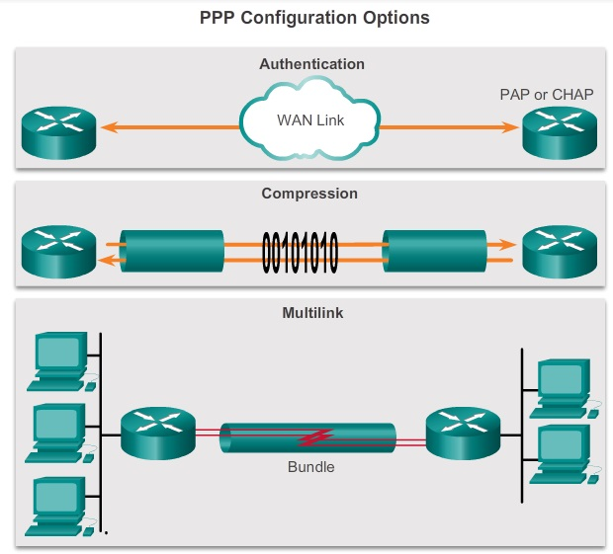
PPP

Slide 38
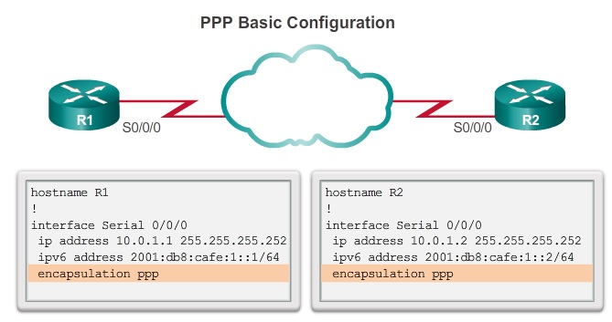
Configuring PPP

Slide 39
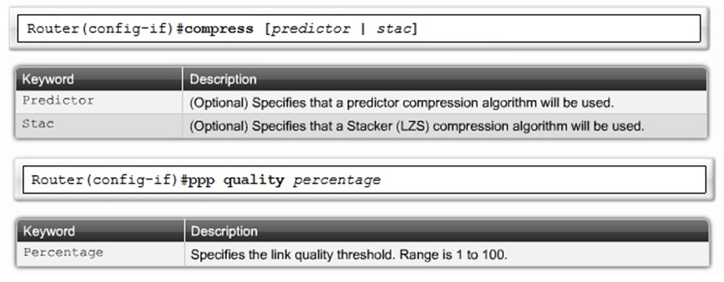
Configuring PPP

Slide 40
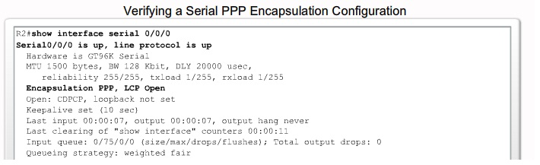
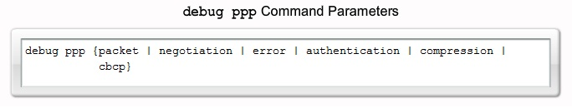
Configuring PPP

Slide 41
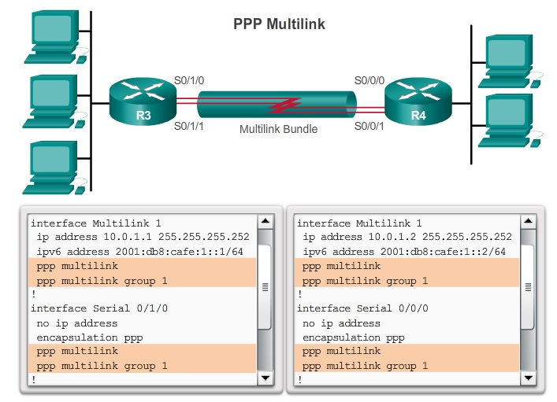
Configuring PPP

Slide 42
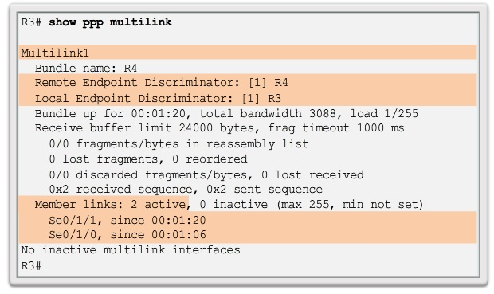
Configuring PPP

Slide 43
PPP Authentication
PPP defines an extensible LCP that allows negotiation of an authentication protocol for authenticating its peer before allowing Network layer protocols to transmit over the link.
Password Authentication Protocol (PAP)
  a very basic two-way process.
  username and password are sent in plain text and sent as one LCP data package
  If it is accepted, the connection is allowed.

Slide 44
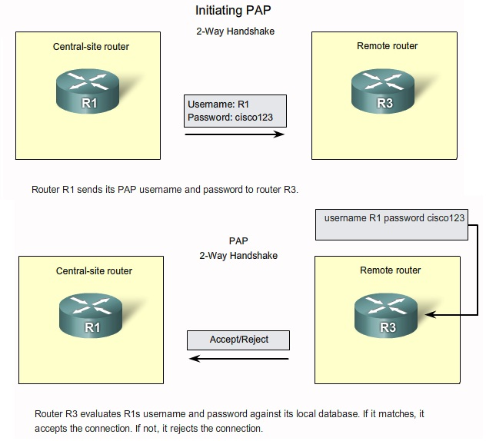

Slide 45
PPP Authentication
Challenge Handshake Authentication Protocol (CHAP)
  Three-way exchange of a shared secret.
  The local router sends a challenge message to the remote node.
  The remote node responds with a value calculated using a one-way hash function, which is typically Message Digest 5 (MD5) based on the password and challenge message.
  The local router checks the response against its own calculation of the expected hash value. If the values match, the initiating node acknowledges the authentication. Otherwise, it immediately terminates the connection.

Slide 46
PPP Authentication
  CHAP conducts periodic challenges to make sure that the remote node still has a valid password value.
  CHAP provides protection against playback attack by using a variable challenge value that is unique and unpredictable.
  The use of repeated challenges limits the time of exposure to any single attack.

Slide 47
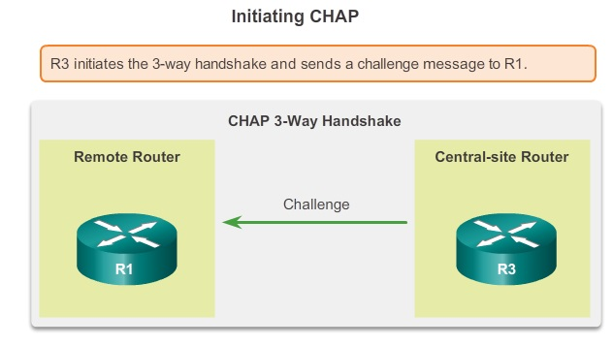
PPP Authentication

Slide 48
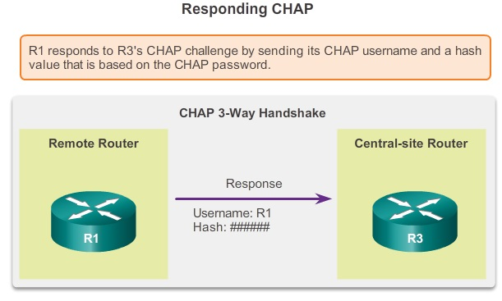
PPP Authentication

Slide 49
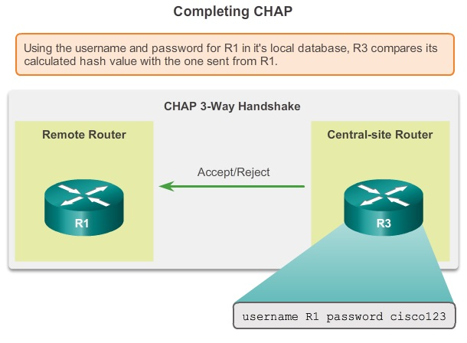
PPP Authentication

Slide 50
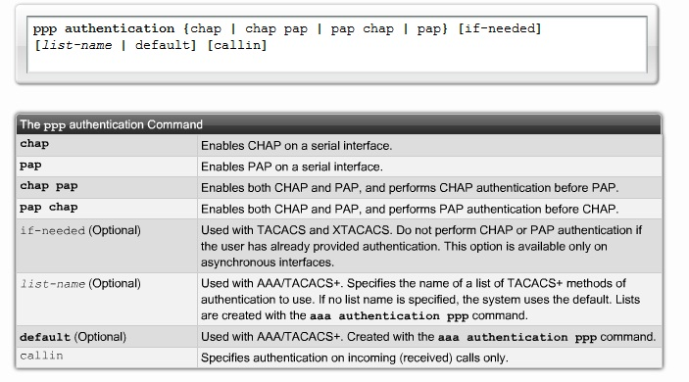
Configuring PPP Authentication

Slide 51
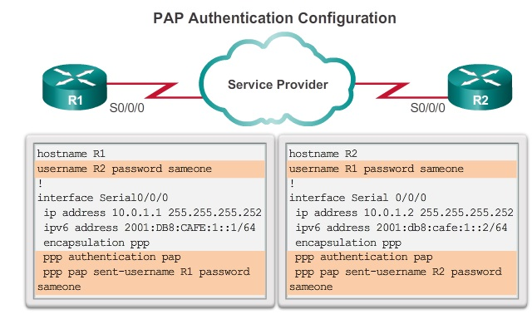
Configuring PPP Authentication

Slide 52
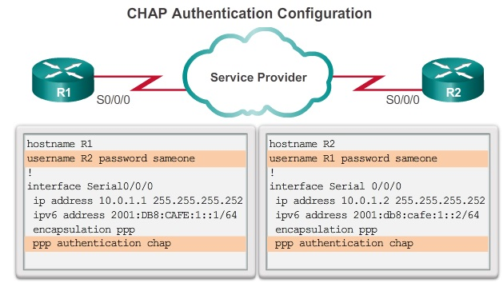
Configuring PPP Authentication

Slide 53
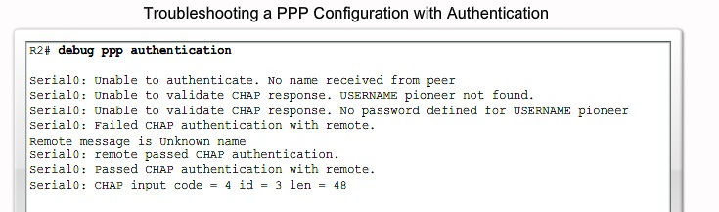
Configuring PPP Authentication

